Slide 1

Parabola Applied example 2
RCET 0264 Introductory Calculus
Tim Leishman

Slide 2
Parabola
A culvert is shaped like a parabola, 120cm across the top and 80cm deep. How wide is the culvert 50cm from the top?

Slide 3
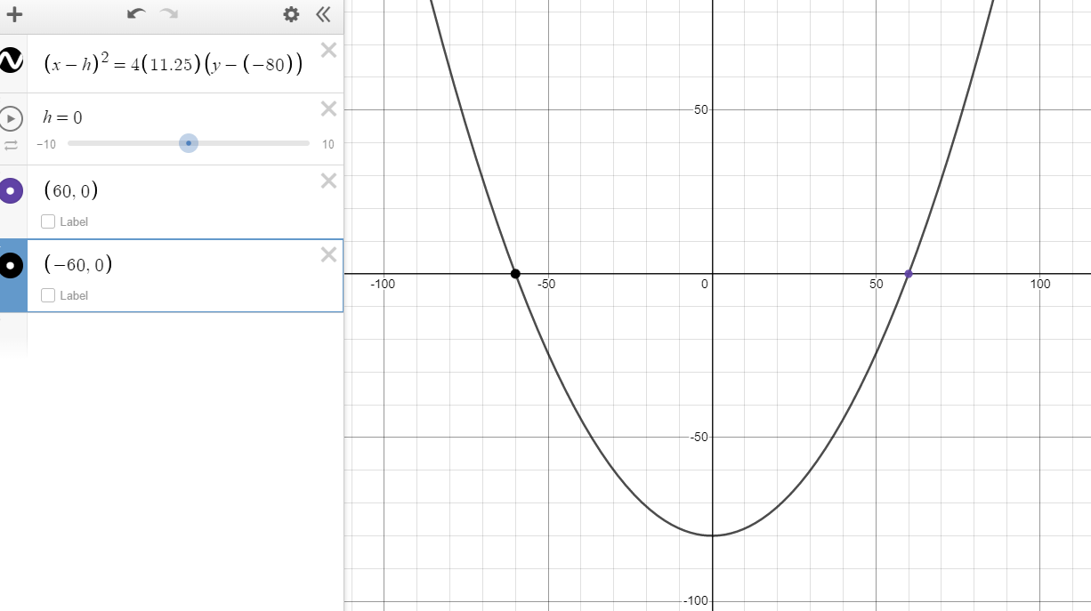

Parabola
A culvert is shaped like a parabola, 120cm across the top and 80cm deep. How wide is the culvert 50cm from the top?
Solve for p:
$x^{2}=4py$
$({x−h)}^{2}=4p(y−k)$
$({x−0)}^{2}=4p(y−(−80))$
$({x)}^{2}=4p(y+80)$
Points (x, y) on parabola
(60, 0) & (-60, 0)
$({x)}^{2}=4p(y+80)$
$({−60)}^{2}=4p(0+80)$
$p=\frac{{−60}^{2}}{(4×80)}$
$p=\frac{3600}{320}$
$p=11.25$

Slide 4

Parabola
A culvert is shaped like a parabola, 120cm across the top and 80cm deep. How wide is the culvert 50cm from the top?
$p=11.25$
How wide is the culvert 50cm from the top?
x = ?, y = -50cm
Solve for x when y = -50cm
$({x)}^{2}=4p(−50+80)$
$({x)}^{2}=4(11.25)(30)$
$({x)}^{2}=1350$
$x=√1350$
$x=36.7423 \& −36.7423$

Slide 5
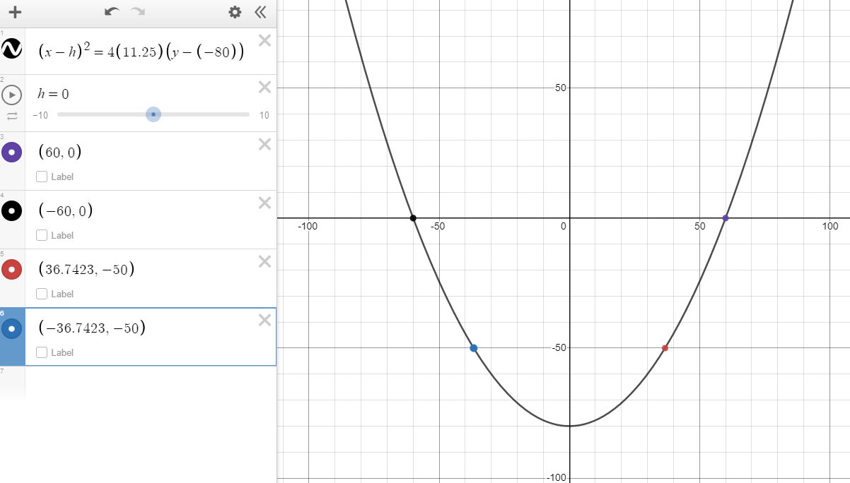


Parabola
A culvert is shaped like a parabola, 120cm across the top and 80cm deep. How wide is the culvert 50cm from the top?
$p=11.25$
How wide is the culvert 50cm from the top?
x = ?, y = -50cm
when y = -50cm
$x=36.7423 \& −36.7423$
How wide is the culvert 50cm from the top?
We can see that the width is from $x=−36.7423cm to+36.7423cm$
Thus, the total width at the depth of 50cm is $36.7423×2=73.4847cm$
${width}_{−50cm}=73.7847cm$

Slide 6
Parabola
References:
Ewen, D., Gary, J. S., & Trefzger, J. E. (2005). Technical calculus. Upper Saddle River, NJ: Pearson/Prentice Hall.
https://www.desmos.com/calculator/zs5wfg9uem

